Slide 1
ROAD SIGN RECOGNITION USING CNN
Presented By
Hridhya Haridas
DA&DS(March)

Slide 2
Project overview
Objective: Build a convolutional Neural Network to classify road signs.
Approach : Data preprocessing >CNN Model >Evaluation >Streamlit UI

Slide 3
PROJECT WORKFLOW
DATA COLLECTION
DATA PREPROCESSING
CNN MODEL
TRAINING
EVALUATION
STREAMLIT UL

Slide 4
DATA COLLECTION
Downloaded Road Sign Data Set
Loaded Images and Labels into Python Environment
DATA PREPROCESSING
Resized images to consistent shape
Normalized pixel Values

Slide 5
CNN ARCHITECTURE
Input Layer>Conv Layers> Pooling>Flatten>Dense>Output
Activation : ReLU for hidden layers, Softmax for output layer
CNN Layers

Slide 6
CNN LAYERS
Convolutional Layers extract spatial features
Max-Pooling reduces dimensionality
Fully Connected Layers classify images

Slide 7
DATA Spitting
Training: 70%
Validation: 15%
Testing: 15%
Layers

Slide 8
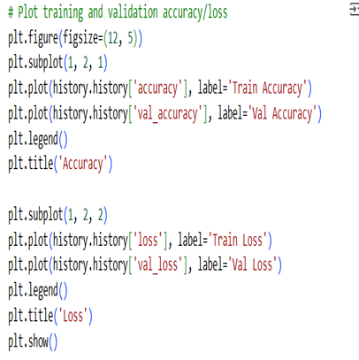
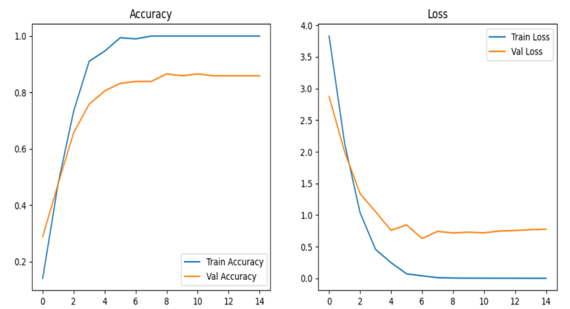
TRAINING

Slide 9
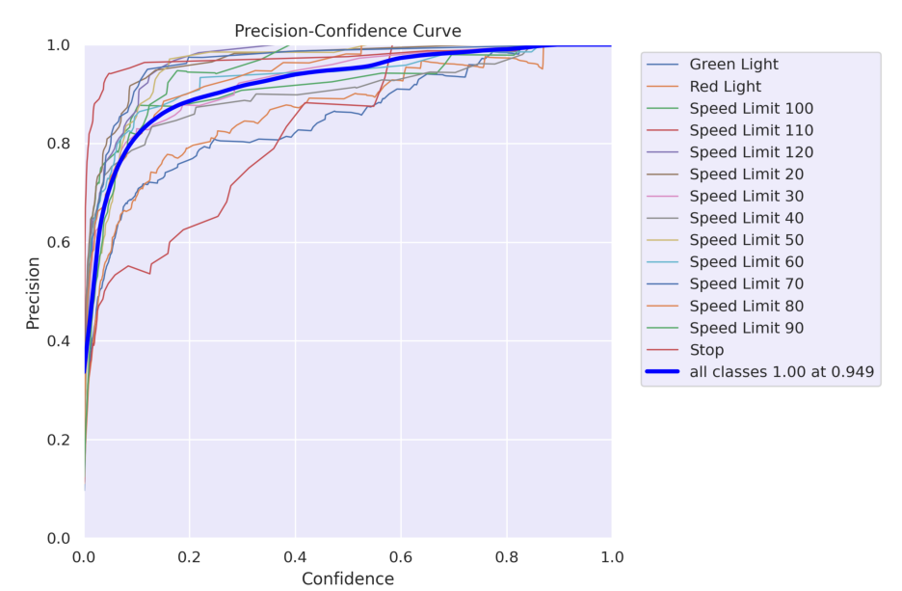
PRECISION CONFIDENCE CURVE

Slide 10
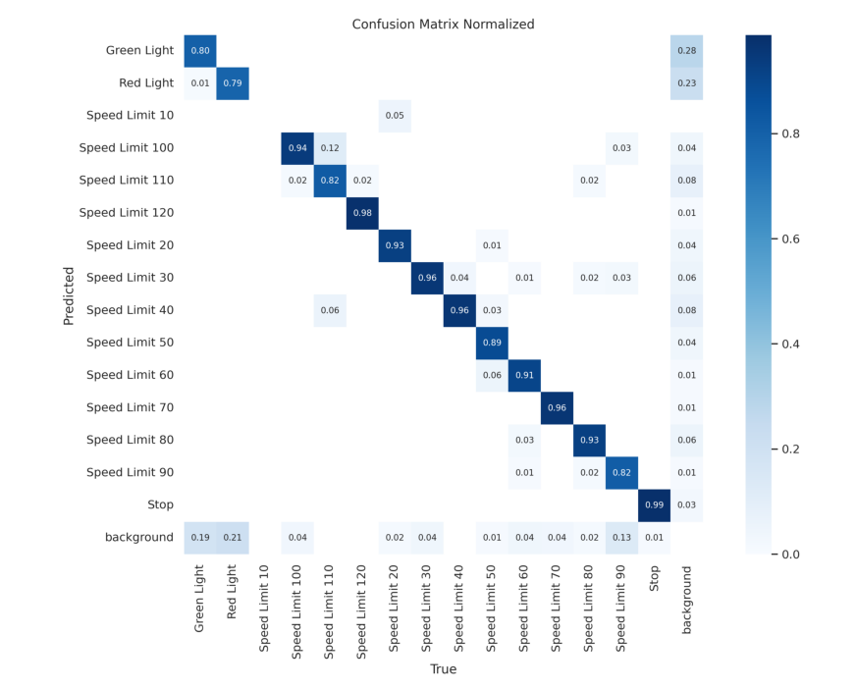
TESTING

Slide 11
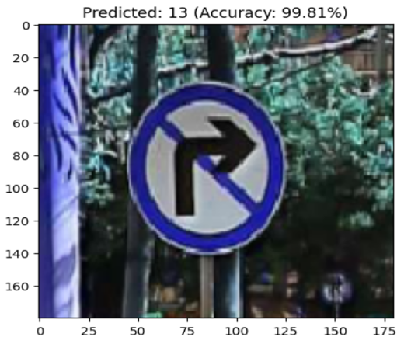
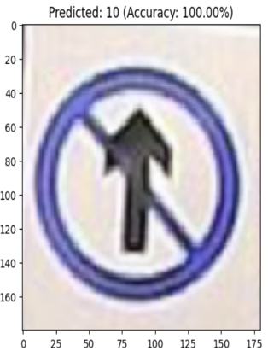
PREDICTION

Slide 12
Model Optimization
Tried different CNN architectures
• Added dropout layers
• Balanced performance and complexity

Slide 13
Streamlit UI
• Built interactive UI to upload test images
• Displayed accuracy and predicted class
• Easy for end-users to test the model

Slide 14
CONCLUSION
Results: High model accuracy and successful road sign recognition

Slide 15

THANK YOU

